Slide 1
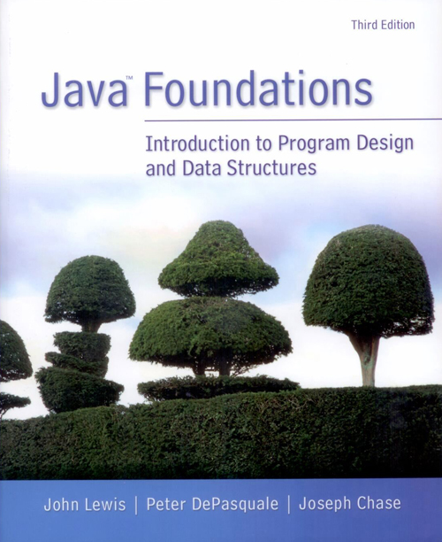
Chapter 7
Arrays
Notes:
Array: an orderly arrangement

Slide 2
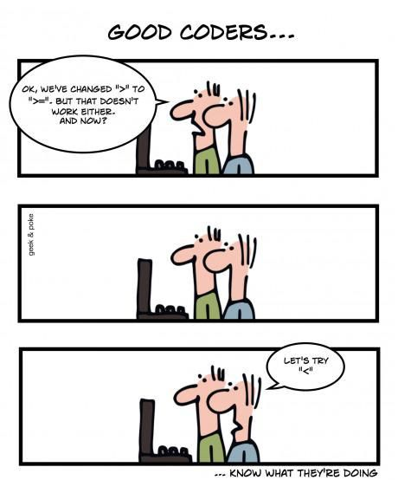

Slide 3
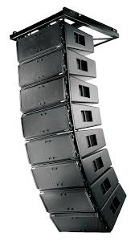
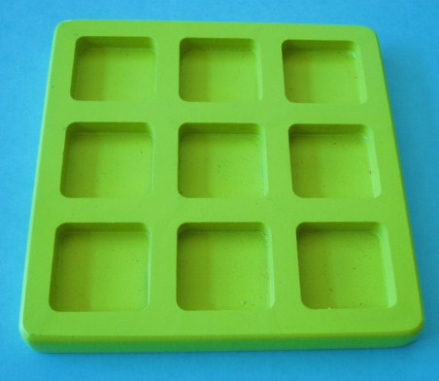
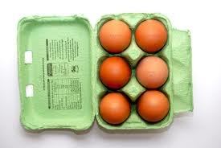
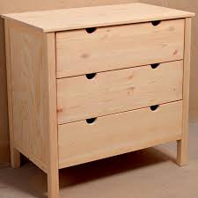
1. Arrays

Slide 4
Arrays
An array is an ordered list of same type values.
The entire array
has a single name.
Each value has a numeric index.
0 1 2 3 4 5 6 7 8 9
scores
79 87 94 82 67 98 87 81 74 91
An element
An array of size N is indexed from 0 to N-1.
This array holds 10 values that are indexed from 0 to 9.
Similar to the indexes in a String value.
Notes:
Array: an orderly arrangement;

Slide 5
Arrays
Why arrays?
Store data into storage, i.e., a variable
Use the data again and again
E.g., read multiple values and save them in an array, and
Find the average
Find the largest
Sort values in ascending order
Find the mean and the variance
Search a value
…
Notes:
Array: an orderly arrangement;

Slide 6
Arrays
An array is an ordered list of same type values.
The entire array
has a single name.
Each value has a numeric index.
0 1 2 3 4 5 6 7 8 9
scores
79 87 94 82 67 98 87 81 74 91
An element
An array of size N is indexed from 0 to N-1.
This array holds 10 values that are indexed from 0 to 9.
[Q] How to access each element?
Notes:
Array: an orderly arrangement;

Slide 7
Arrays
A particular value in an array is referenced using the array name followed by the index in square brackets.
In the previous example, the expression
scores[2]
refers to the value 94 (the 3rd value in the array).
That expression represents a place to store a single integer and can be used wherever an integer variable can be used. That is elements are variables.

Slide 8
Arrays
Summary: How many different brackets have you know?
{ } for what ???
( ) for what ???
[ ] for what ???

Slide 9
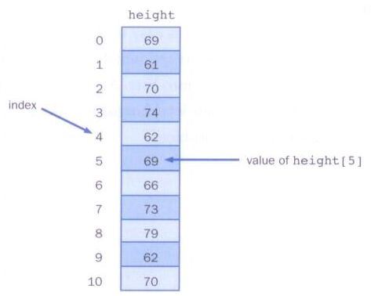
Arrays
Arrays can be depicted vertically or horizontally

Slide 10
Arrays
A variable
An array element can be assigned a value, printed, or used in a calculation.
scores[2] = 89;
scores[first] = scores[first] + 2;
mean = (scores[0] + scores[1])/2;
System.out.println("Top = " + scores[5]);
int type
scores[2] and scores[first] are variables.
Names are usually plurals.

Slide 11
Arrays
Each room holding a value in an array is called array element.
Array elements are actually considered as variables.
An array stores multiple values of the same type – the element type.
The element type can be a primitive type or an object reference.
Therefore, we can create an array of integers, an array of characters, an array of String objects, an array of Coin objects, etc.
E.g. main(String[] args).
In Java, the array itself is an object that must be instantiated.

Slide 12
2. Declaring Arrays
The scores array could be declared as follows.
int[] scores = new int[10];
The type of the variable scores is int[] (an array of integers).
Note that the array type does not specify its size, but each object of that type has a specific size.
The reference variable scores is set to a new array object that can hold 10 integers.

Slide 13
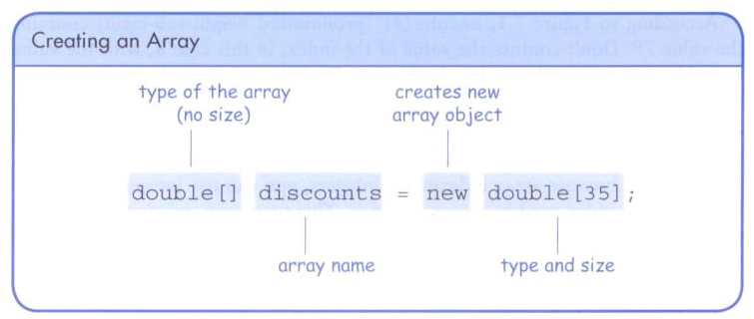
Declaring Arrays

Slide 14
Declaring Arrays
Some other examples of array declarations.
double[] prices = new double[500];
boolean[] flags;
flags = new boolean[20];
int n = Util.readInt(50);
char[] codes = new char[n];

Slide 15
Using Arrays
The for-each loop can be used when processing array elements:
for (int score : scores)
System.out.println(score); // score:
// not index,
// element value,
// not scores[0], …
This is only appropriate when processing all array elements from the lowest index to the highest index.

Slide 16
public class BasicArray
{
public static void main(String[] args)
{
final int LIMIT = 15, MULTIPLE = 10;
int[] list = new int[LIMIT];
// Initialize the array values
for (int index = 0; index < LIMIT; index++)
list[index] = index * MULTIPLE;
list[5] = 999; // change one array value
// Print the array values
for (int value : list)
System.out.print(value + " ");
Systme.out.println();
}
}

Slide 17
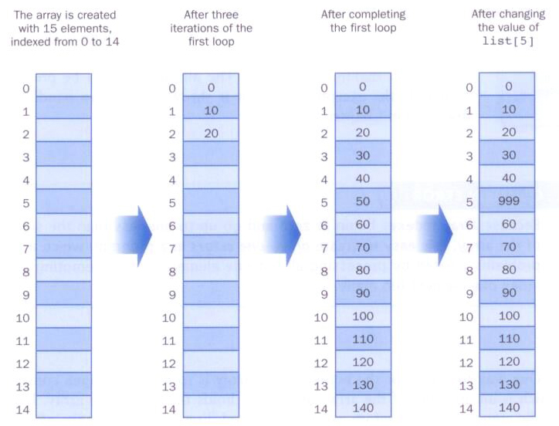
BasicArray Example
list[5]=999;

Slide 18
import java.io.*;
import java.util.Scanner;
public class BasicArray2
{
public static void main(String[] args) throws IOException
{
File inputFile = new File("data.txt");
Scanner scan = new Scanner(inputFile);
int no;
no = scan.nextInt();
??? list = ???? // integer array of no-many elements
// Read values from the file and save them in the array
for (int i = 0; i < no; i++) // 0, 1, ..., no - 1
??? = scan.nextInt();
// Print the array values
for (int i = 0; ???; i++)
System.out.print(??? + " ");
Systme.out.println();
}
}
5
10
20
-13
57
-45
Try with http://cs.tru.ca/~mlee/comp1130/Fall2019/8. arrays/BasicArray2.java and
http://cs.tru.ca/~mlee/comp1130/Fall2019/8. arrays/data.txt.

Slide 19
Bounds Checking
Once an array is created, it has a fixed size. The cannot be changed.
An index used in an array reference must specify a valid element.
That is, the index value must be in range 0 to N-1.
The Java interpreter throws an ArrayIndexOutOfBoundsException if an array index is out of bounds.
This is called automatic bounds checking.

Slide 20
Bounds Checking
For example, if the array codes can hold 100 values, it can be indexed using only the numbers 0 to 99.
If the value of count is 100, then the following reference will cause an exception to be thrown.
System.out.println(codes[count]);
It’s very common to introduce off-by-one errors when using arrays.
problem
for (int index=0; index <= 100; index++)
codes[index] = index*50 + epsilon;

Slide 21
Bounds Checking
Each array object has a public constant called length that stores the size of the array. Not method.
It is referenced using the array name.
scores.length
Note that length holds the number of elements, not the largest index.
Remember the size of a String object word is word.length()

Slide 22
Length for String and array
String input = "Java";
System.out.println(input.length());
int[] scores = new int[5];
System.out.println(scores.length);

Slide 23
import java.util.Scanner;
public class ReverseOrder
{
public static void main(String[] args) {
Scanner scan = new Scanner(System.in);
double[] numbers = new double[10];
System.out.println("The size of the array: " + numbers.length);
for (int index = 0; index < numbers.length; index++) {
System.out.print("Enter number " + (index+1) + ": ");
numbers[index] = scan.nextDouble();
}
System.out.println("The numbers in reverse order:");
for (int index = ???; ???; ???)
System.out.print(numbers[index] + " ");
}
}

Slide 24
import java.util.Scanner;
public class ReverseOrder
{
public static void main(String[] args) {
Scanner scan = new Scanner(System.in);
double[] numbers = new double[10];
System.out.println("The size of the array: " + numbers.length);
for (int index = 0; index < numbers.length; index++) {
System.out.print("Enter number " + (index+1) + ": ");
numbers[index] = scan.nextDouble();
}
System.out.println("The numbers in reverse order:");
for (int index = numbers.length-1; index >= 0; index--)
System.out.print(numbers[index] + " ");
}
}

Slide 25
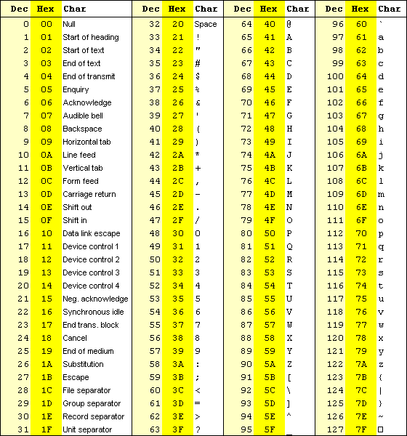

Slide 26
import java.util.Scanner;
public class LetterCount {
public static void main(String[] args) {
final int NUMCHARS = 26;
Scanner scan = new Scanner(System.in);
int[] upper = new int[NUMCHARS]; // upper[0]: 'A', upper[1]: 'B', ...
int[] lower = new int[NUMCHARS]; // lower[0]: 'a', lower[1]: 'b', ...
int other = 0; // counter for non-alphabetics
char currentChar; // the current character being processed
System.out.println("Enter a sentence:");
String line = scan.nextLine();
// Count the number of each letter occurrence
for (int ch = 0; ch < line.???; ch++) {
currentChar = line.charAt(ch);
if (currentChar >= 'A' && currentChar <= 'Z')
upper[currentChar-'A']++; // 'A' – 'A' -> 0; 'B' – 'A' -> 1, ...
else if (currentChar >= 'a' && currentChar <= 'z')
lower[currentChar-???]++;
else
other++;
}

Slide 27
import java.util.Scanner;
public class LetterCount {
public static void main(String[] args) {
final int NUMCHARS = 26;
Scanner scan = new Scanner(System.in);
int[] upper = new int[NUMCHARS]; // upper[0]: 'A', upper[1]: 'B', ...
int[] lower = new int[NUMCHARS]; // lower[0]: 'a', lower[1]: 'b', ...
int other = 0; // counter for non-alphabetics
char currentChar; // the current character being processed
System.out.println("Enter a sentence:");
String line = scan.nextLine();
// Count the number of each letter occurrence
for (int ch = 0; ch < line.length(); ch++) {
currentChar = line.charAt(ch);
if (currentChar >= 'A' && currentChar <= 'Z')
upper[currentChar-'A']++; // 'A' – 'A' -> 0; 'B' – 'A' -> 1, ...
else if (currentChar >= 'a' && currentChar <= 'z')
lower[currentChar-'a']++;
else
other++;
}

Slide 28
// Print the results
System.out.println ();
for (int letter=0; letter < upper.length; letter++)
{
System.out.print((char)(letter + 'A')); // 1 + 'A' -> 'B'
System.out.print(": " + upper[letter]);
System.out.print("\t\t" + (char)(letter + 'a'));
System.out.println(": " + lower[letter]);
}
System.out.println();
System.out.println("Non-alphabetic characters: " + other);
}
}

Slide 29
LetterCount
current = 'A';
upper[current-'A']++;
→ upper['A'-'A']++; → upper[65-65]++; → upper[0]++;
current = 'Z';
upper[current-'A']++;
→ upper['Z'-'A']++; → upper[90-65]++; → upper[25]++;
current = 'b';
lower[current-'a']++;
→ lower['b'-'a']++; → lower[98-97]++; → lower[1]++;
current = 's';
lower[current-'a']++;
→ lower['s'-'a']++; → lower[115-97]++; → lower[18]++;

Slide 30
Alternate Array Syntax
The brackets of the array type can be associated with the element type or with the name of the array.
double[] prices, rate; // they are arrays.
double prices[], rate; // rate is not an array.

Slide 31
Some of Common Array Algorithms
Filling
Reading values
Sum
Average value
Maximum
Minimum
Search a value
Element separators
Reading values from a file, writing values to a file

Slide 32
Common algorithm – filling
This loop fills an array with squares (0, 1, 4, 9, 16, ...). Note that the element with index 0 contains 0², the element with index 1 contains 1², and so on.
for (int i = 0; i ??? values.length; i++) {
values[???] = i * i;
}

Slide 33
Common algorithm – reading input
If you know how many inputs the user will supply, it is simple to place them into an array:
int n = Util.readInt(10);
double[] inputs = new double[n];
for (i = 0; i < inputs.???; i++)
inputs[i] = in.nextDouble(); // in ?

Slide 34
Common algorithm – filling
Test the above program with
http://cs.tru.ca/~mlee/comp1130/Fall2016/6. chapter7/Util.java.
http://cs.tru.ca/~mlee/comp1130/Fall2016/6. chapter7/TestArrayFilling.java.

Slide 35
Common algorithm – sum and average
When the values are located in an array, the code looks much simpler:
double total = 0;
for (double element ??? values) {
total = total + element;
}
double average = 0;
if (values.length > 0) {
average = total / values.???;
}

Slide 36
Common algorithm – sum and average
When the values are located in an array, the code looks much simpler:
double total = 0;
for (int i = 0; ???; i++) {
total = total + values[???];
}
double average = 0;
if (values.length > 0) {
average = total / values.???;
}

Slide 37
Common algorithm – sum and average
Test the above program with
http://cs.tru.ca/~mlee/comp1130/Fall2016/6. chapter7/Util.java.
http://cs.tru.ca/~mlee/comp1130/Fall2016/6. chapter7/TestArraySumAverage.java.

Slide 38
Common algorithm – maximum
Keep a variable for the largest element already encountered. Here is the implementation of that algorithm for an array:
double largest = values[???]; // start with the 1st
for (int i = ???; ???; i++) {
if (???)
largest = values[i];
}
Note that the loop starts at 1 because we initialize largest with values[0].
This algorithm requires that the array contain at least one element.

Slide 39
Common algorithm – minimum
Keep a variable for the smallest element already encountered. Here is the implementation of that algorithm for an array:
double smallest = values[???];
for (int i ???; ???; ???) {
if (???)
smallest = values[i];
}
Note that the loop starts at 1 because we initialize largest with values[0].
This algorithm requires that the array contain at least one element.

Slide 40
Common algorithm – max, min
Test the above program with
http://cs.tru.ca/~mlee/comp1130/Fall2016/6. chapter7/Util.java.
http://cs.tru.ca/~mlee/comp1130/Fall2016/6. chapter7/TestArrayMaxMin.java.

Slide 41
Common algorithm – search
Find a value in an array and print the index of the value:
double valueToFind = scan.nextDouble();
int i;
for (i = 0; i ??? values.length; i++) {
if (values[i] ??? valueToFind)
break;
}
if (???) // not found
i = -1; // -1 means ‘not found’ in this algorithm
System.out.println("The position of " + valueToFind +
" = " + i);

Slide 42
Common algorithm – search
Find a value in an array and print the index of the value:
double valueToFind = scan.nextDouble();
int i;
for (i = 0; i < values.length; i++) {
if (values[i] == valueToFind)
break;
}
if (i == values.length) // not found
i = -1; // -1 means ‘not found’ in this algorithm
System.out.println("The position of " + valueToFind +
" = " + i);

Slide 43
Common algorithm – search
Find a value in an array and print the index of the value:
double valueToFind = scan.nextDouble();
boolean found = false;
int i;
for (i = 0; i < values.length; i++) {
if (values[i] == valueToFind) {
found = true;
break;
}
}
if (???) // not found
i = -1; // -1 means ‘not found’ in this algorithm
System.out.println("The position of " + valueToFind +
" = " + i);

Slide 44
Common algorithm – search
Test the above program with
http://cs.tru.ca/~mlee/comp1130/Fall2016/6. chapter7/Util.java.
http://cs.tru.ca/~mlee/comp1130/Fall2016/6. chapter7/TestArraySearch.java.

Slide 45
Common algorithm – element separators
Print the separator before each element in the sequence except the initial one (with index 0) like this:
for (int i = 0; i < values.length; i++) {
if (i > 0)
System.out.print(" | ");
System.out.print(values[i]);
}
If you want comma separators, you can use the Arrays.toString method.
Arrays.toString(values)

Slide 46
Another example – Sine graph using TBGP
Try it!
SinGraph
trubgp library
http://cs.tru.ca/~mlee/comp1130/Fall2019/8. arrays/trubgp/BGPEventListener.class
http://cs.tru.ca/~mlee/comp1130/Fall2019/8. arrays/trubgp/Board$1.class
http://cs.tru.ca/~mlee/comp1130/Fall2019/8. arrays/trubgp/Board$2.class
http://cs.tru.ca/~mlee/comp1130/Fall2019/8. arrays/trubgp/Board.class
http://cs.tru.ca/~mlee/comp1130/Fall2019/8. arrays/trubgp/Cell$1.class
http://cs.tru.ca/~mlee/comp1130/Fall2019/8. arrays/trubgp/Cell.class
SinGraph.java

Slide 47
Initializer Lists
An initializer list can be used to instantiate and fill an array in one step.
The values are delimited by braces and separated by commas.
Examples:
int[] units = {147, 323, 89, 933, 540,
269, 97, 114, 298, 476}; // Not [ ... ]
char[] letterGrades = {'A', 'B', 'C', 'D', 'F'};

Slide 48
Initializer Lists
Examples:
int[] units = {147, 323, 89, 933, 540,
269, 97, 114, 298, 476}; // Not [ ... ]
char[] letterGrades = {'A', 'B', 'C', 'D', 'F'};
Note that when an initializer list is used
the new operator is not used.
no size value is specified.
The size of the array is determined by the number of items in the initializer list.
An initializer list can be used only in the array declaration.

Slide 49
public class Primes
{
public static void main(String[] args)
{
int[] primeNums = ??? 2, 3, 5, 7, 11, 13, 17, 19 ???;
System.out.println("Array length: " + primeNums.???);
System.out.println("The first few prime numbers are:");
for (int prime : primeNums)
System.out.print(prime + " ");
}
}

Slide 50
public class Primes
{
public static void main(String[] args)
{
int[] primeNums = {2, 3, 5, 7, 11, 13, 17, 19};
System.out.println("Array length: " + primeNums.length);
System.out.println("The first few prime numbers are:");
for (int prime : primeNums)
System.out.print(prime + " ");
}
}

Slide 51
Practice
Write a program that reads in ten numbers and displays distinct numbers (i.e., if a number appears multiple times, it is displayed only once). Here is the sample run of the program:

Slide 52
Practice
Algorithm:
data[] <- read 10 values;
for i from 0 to data.length – 1
if data[i] was not printed yet // How ???
print data[i];

Slide 53
Practice
Algorithm:
data[] <- read 10 values;
for i from 0 to data.length – 1
for j from 0 to ???
if (data[j] == data[i])
break;
if (???)
print data[i];

Slide 54
Practice
Algorithm:
data[] <- read 10 values;
for i from 0 to data.length – 1
for j from 0 to i-1
if (data[j] == data[i])
break;
if (j == i)
print data[i];

Slide 55
Arrays as Parameters
An entire array can be passed as a parameter to a method. (Note that arrays are objects.)
Like any other object, the reference to the array is passed, making the formal and actual parameters aliases of each other.
Therefore, changing an array element within the method changes the original.
An individual array element can be passed to a method as well, in which case the type of the formal parameter is the same as the element type.

Slide 56
Arrays as Parameters
Test the above program with
http://cs.tru.ca/~mlee/comp1130/Fall2016/6. chapter7/UtilArrayParameter.java.
http://cs.tru.ca/~mlee/comp1130/Fall2016/6. chapter7/TestArrayParameter.java.

Slide 57
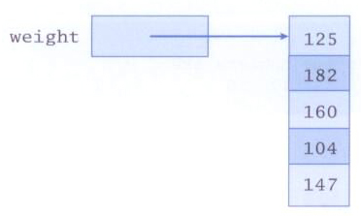
3. Arrays of Objects
An array is an object and an array can hold objects as elements.
The array name is an object reference variable.
So this is another way to depict an array:

Slide 58
Arrays of Objects
An array of objects really holds object references.
The following declaration reserves space to store 5 references to String objects.
String[] words = new String[5];
It does not create the String objects themselves.
Initially an array of objects holds null references.
Each object stored in an array must be instantiated separately.
Notes:
null is a keyword in Java.
null is the default value of any reference type null is not Object or neither a type. null can only be assigned to reference type, you cannot assign null to primitive variables.

Slide 59
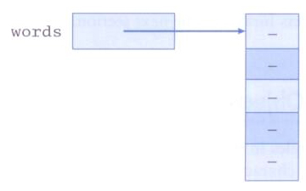
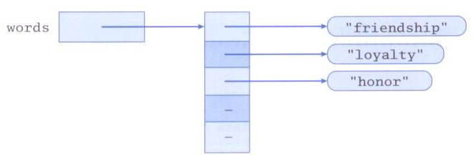
Arrays of Objects
After initial creation, an array holds null references:
Each element is a reference to an object:
null is a keyword in Java.
null is the default value of any reference type null is not Object or neither a type. null can only be assigned to reference type, you cannot assign null to primitive variables.

Slide 60
Arrays of Objects
Keep in mind that String objects can be created using literals.
The following declaration creates an array object called verbs and fills it with four String objects created using string literals.
String[] verbs = {"play", "work", "eat", "sleep"};
The following example creates an array of Grade objects, each with a string representation and a numeric lower bound.

Slide 61
public class GradeRange
{
public static void main(String[] args)
{
Grade[] grades = new Grade[12];
grades[0] = new Grade("A", 95);
grades[1] = new Grade("A-", 90);
grades[2] = new Grade("B+", 87);
grades[3] = new Grade("B", 85);
grades[4] = new Grade("B-", 80);
grades[5] = new Grade("C+", 77);
grades[6] = new Grade("C", 75);
grades[7] = new Grade("C-", 70);
grades[8] = new Grade("D+", 67);
grades[9] = new Grade("D", 65);
grades[10] = new Grade("D-", 60);
grades[11] = new Grade("F", 0);
System.out.println("The first grade = " + grades[0].getName());
for (Grade letterGrade : grades) // data type of letterGrade?
System.out.println(letterGrade);
}
}

Slide 62
public class GradeRange
{
public static void main(String[] args)
{
Grade[] grades =
{
new Grade("A", 95), new Grade("A-", 90),
new Grade("B+", 87), new Grade("B", 85), new Grade("B-", 80),
new Grade("C+", 77), new Grade("C", 75), new Grade("C-", 70),
new Grade("D+", 67), new Grade("D", 65), new Grade("D-", 60),
new Grade("F", 0)
};
System.out.println("The first grade = " + grades[0].getName());
for (Grade letterGrade : grades) // data type of letterGrade?
System.out.println(letterGrade);
}
}
OR

Slide 63
public class Grade
{
private String name;
private int lowerBound;
public Grade(String grade, int cutoff)
{
name = grade;
lowerBound = cutoff;
}
public String toString()
{
return name + "\t" + lowerBound;
}

Slide 64
public void setName(String grade)
{
name = grade;
}
public void setLowerBound(int cutoff)
{
lowerBound = cutoff;
}
public String getName()
{
return name;
}
public int getLowerBound()
{
return lowerBound;
}
}

Slide 65
Test the above program with
http://cs.tru.ca/~mlee/comp1130/Fall2016/6. chapter7/Friend.java.
http://cs.tru.ca/~mlee/comp1130/Fall2016/6. chapter7/TestArrayFriends.java.
Main in TestArrayFriends invokes other methods in the same class. It is not much different from that gcd() invokes getSmaller() in Util in previous examples.

Slide 66
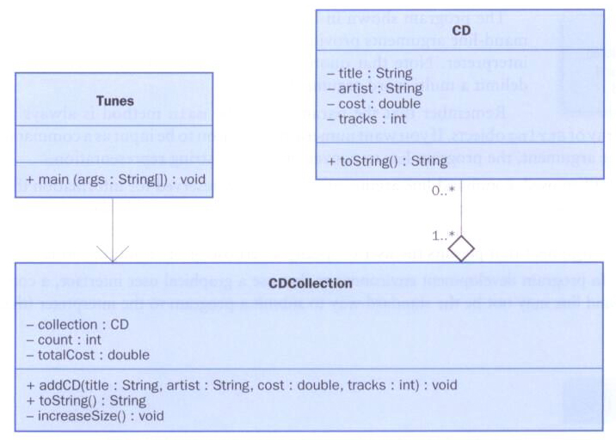
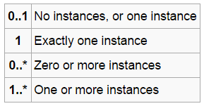
Arrays of Objects
Now let's look at an example that stores a collection of CD objects
Multiplicity
Multiplicity: indicates how many of the objects at this end can be linked to each object at the other

Slide 67
UML Class Diagrams
https://msdn.microsoft.com/en-us/library/dd409416.aspx
Multiplicity: indicates how many of the objects at this end can be linked to each object at the other.
1 - this attribute has a single value of the specified Type.
0..1 - this attribute can have a value of null.
* - this attribute's value is a collection of values.
1..* - this attribute's value is a collection that contains at least one value.
n .. m - this attribute's value is a collection that contains between n and m values.

Slide 68
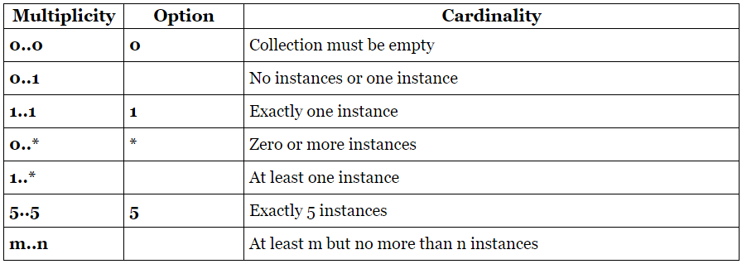
UML Class Diagrams: Multiplicity
http://www.uml-diagrams.org/multiplicity.html

Slide 69
UML Class Diagrams: Multiplicity

Slide 70
//********************************************************************
// Tunes.java Java Foundations
//
// Demonstrates the use of an array of objects.
//********************************************************************
public class Tunes
{
//-----------------------------------------------------------------
// Creates a CDCollection object and adds some CDs to it. Prints
// reports on the status of the collection.
//-----------------------------------------------------------------
public static void main (String[] args)
{
CDCollection music = new CDCollection ();
music.addCD("Storm Front", "Billy Joel", 14.95, 10);
music.addCD("Come On Over", "Shania Twain", 14.95, 16);
music.addCD("Soundtrack", "Les Miserables", 17.95, 33);
music.addCD("Graceland", "Paul Simon", 13.90, 11);
System.out.println(music);
music.addCD("Double Live", "Garth Brooks", 19.99, 26);
music.addCD("Greatest Hits", "Jimmy Buffet", 15.95, 13);
System.out.println(music);
}
}

Slide 71
//********************************************************************
// CDCollection.java Java Foundations
//
// Represents a collection of compact discs.
//********************************************************************
import java.text.NumberFormat;
public class CDCollection
{
private CD[] collection; // CD ???
private int count;
private double totalCost;
//-----------------------------------------------------------------
// Constructor: Creates an initially empty collection.
//-----------------------------------------------------------------
public CDCollection()
{
collection = new CD[100];
count = 0;
totalCost = 0.0;
}

Slide 72
//-----------------------------------------------------------------
// Adds a CD to the collection, increasing the size of the
// collection if necessary.
//-----------------------------------------------------------------
public void addCD(String title, String artist, double cost,
int tracks)
{
if (count == collection.length){
increaseSize();
}
collection[count] = new CD(title, artist, cost, tracks);
totalCost += cost;
count++;
}

Slide 73
//-----------------------------------------------------------------
// Returns a report describing the CD collection.
//-----------------------------------------------------------------
public String toString()
{
NumberFormat fmt = NumberFormat.getCurrencyInstance();
String report = "~~~~~~~~~~~~~~~~~~~~~~~~~~~~~~~~~~~~~~~~~~~\n";
report += "My CD Collection\n\n";
report += "Number of CDs: " + count + "\n";
report += "Total cost: " + fmt.format(totalCost) + "\n";
report += "Average cost: " + fmt.format(totalCost/count);
report += "\n\nCD List:\n\n";
for (int cd = 0; cd < count; cd++)
report += collection[cd].toString() + "\n";
return report;
}

Slide 74
//-----------------------------------------------------------------
// Increases the capacity of the collection by creating a
// larger array and copying the existing collection into it.
//-----------------------------------------------------------------
private void increaseSize()
{
CD[] temp = new CD[collection.length * 2];
for (int cd = 0; cd < collection.length; cd++){
temp[cd] = collection[cd];
}
collection = temp;
}
}

Slide 75
//********************************************************************
// CD.java Java Foundations
//
// Represents a compact disc.
//********************************************************************
import java.text.NumberFormat;
public class CD
{
private String title, artist;
private double cost;
private int tracks;
//-----------------------------------------------------------------
// Creates a new CD with the specified information.
//-----------------------------------------------------------------
public CD(String name, String singer, double price, int numTracks)
{
title = name;
artist = singer;
cost = price;
tracks = numTracks;
}

Slide 76
//-----------------------------------------------------------------
// Returns a string description of this CD.
//-----------------------------------------------------------------
public String toString()
{
NumberFormat fmt = NumberFormat.getCurrencyInstance();
String description;
description = fmt.format(cost) + "\t" + tracks + "\t";
description += title + "\t" + artist;
return description;
}
}

Slide 77
Intermediate Summary
Declaration of an array – data_type[]
Arrays are objects – .length
Initialization – { ... }
Array of any data types, including objects
Arrays can be passed to a method
A method can return an array
Some simple but important algorithms (operations)

Slide 78
Some of Common Array Methods
Filling
Reading Input
Sum
Average value
Maximum
Minimum
Search a value – linear search
Count
Add

Slide 79
Reading inputs – Util.readIntegers
public static int[] readIntegers(int n)
Algorithm:
Create an array of n elements;
Read integers and save them into the array;
Return the array;
Test the above program with
http://cs.tru.ca/~mlee/comp1130/Fall2016/6. chapter7/Util1.java.
http://cs.tru.ca/~mlee/comp1130/Fall2016/6. chapter7/TestArrayFilling1.java.
It says readIntegers()
will return an int array.

Slide 80
Array of objects
Try with
http://cs.tru.ca/~mlee/comp1130/Fall2016/6. chapter7/Friend.java.
http://cs.tru.ca/~mlee/comp1130/Fall2016/6. chapter7/Util2.java.
A method to create a Friend object and return it
http://cs.tru.ca/~mlee/comp1130/Fall2016/6. chapter7/TestArrayFriends2.java.
A static method with main() in the same class

Slide 81
Min and max
Try with
http://cs.tru.ca/~mlee/comp1130/Fall2016/6. chapter7/Util3.java.
Method overloading with readIntegers()
Passing an array to a method
http://cs.tru.ca/~mlee/comp1130/Fall2016/6. chapter7/TestArrayMaxMin3.java.

Slide 82
Sum and average
Test the above program with
http://cs.tru.ca/~mlee/comp1130/Fall2016/6. chapter7/Util4.java.
Passing an array to a method
Method to add all the values in an array
http://cs.tru.ca/~mlee/comp1130/Fall2016/6. chapter7/TestArraySumAverage4.java.

Slide 83
Linear search
Test the above program with
http://cs.tru.ca/~mlee/comp1130/Fall2016/6. chapter7/Util5.java.
Method to search a value in an array and to return the index of the value
If the value is not in the array, the method returns -1.
http://cs.tru.ca/~mlee/comp1130/Fall2016/6. chapter7/TestArraySearch5.java.

Slide 84
Count
Test the above program with
http://cs.tru.ca/~mlee/comp1130/Fall2016/6. chapter7/Util6.java.
Method to count the values >= a given value
http://cs.tru.ca/~mlee/comp1130/Fall2016/6. chapter7/TestArrayCount6.java.

Slide 85
Sorting data with max, search, count
Try with
http://cs.tru.ca/~mlee/comp1130/Fall2019/8. arrays/Min.java.
http://cs.tru.ca/~mlee/comp1130/Fall2019/8. arrays/data.txt.

Slide 86
More Common Array Methods
Swapping Elements
Copying Arrays
Linear Search
Removing an Element
Inserting an Element
Shifting to right/left
Rotating to right/left
Stack – push() and pop()
Can you write the above methods?

Slide 87
Swapping Elements
You often need to swap elements of an array.
To swap two elements, you need a temporary variable.
Method header definition: ???
... void swap(double[] values, int i, int j)
How to?
double temp = values[i];
values[i] = values[???];
values[???] = temp;

Slide 88
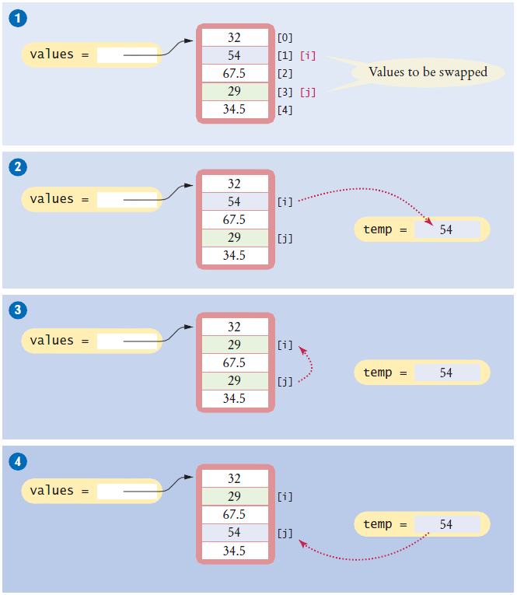

Slide 89
Sorting data with swap
Try with
http://cs.tru.ca/~mlee/comp1130/Fall2019/8. arrays/Swap.java.
http://cs.tru.ca/~mlee/comp1130/Fall2019/8. arrays/data.txt.

Slide 90
Copying Arrays
A method to copy n many elements from an array to a new array and return the new array
Method header definition: ???
... double[] copy(double[] values, int n)
How to?
double[] newValues = new double[???];
for (int i = 0; i < n && i < values.length; i++)
newValues[i] = ???;
???

Slide 91
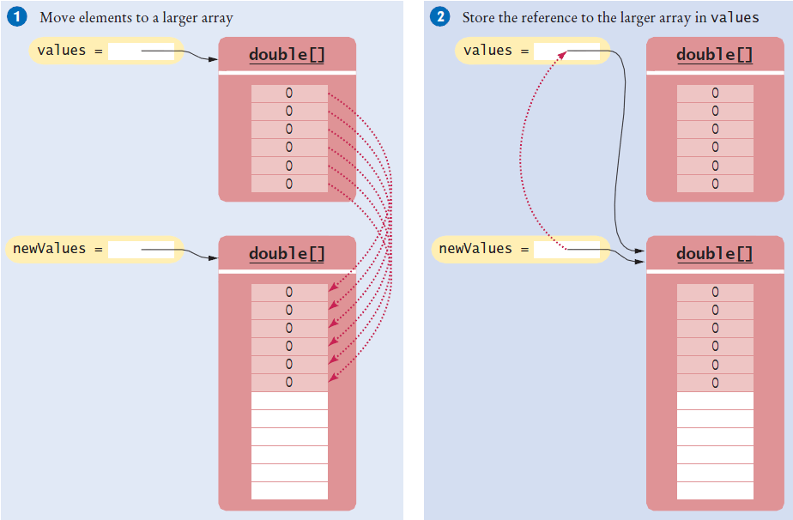

Slide 92
Another Copying Arrays
A method to copy non-negative numbers from an array to a new array and return the new array
Method header definition: ???
... int[] copyNonNegatives(int[] data)
How to?
int n = 0;
for (int i = 0; i < data.length; i++)
if (????)
n++;
int newData[] = ????
n = 0;
for (int i = 0; i < data.length; i++)
if (data[i] >= 0) {
????
????
}
return newData;

Slide 93
Another Copying Arrays
A method to copy non-negative numbers from an array to a new array and return the new array
Method header definition: ???
... int[] copyNonNegatives(int[] data)
How to?
int n = 0;
for (int i = 0; i < data.length; i++)
if (data[i] >= 0)
n++;
int newData[] = new int[n];
n = 0;
for (int i = 0; i < data.length; i++)
if (data[i] >= 0) {
newData[n] = data[i];
n++;
}
return newData;

Slide 94
Linear Search
Linear search is also called sequential search because you inspect the elements in sequence.
You often need to search for the position of a specific element in an array so that you can replace or remove it. Visit all elements until you have found a match or you have come to the end of the array.
In the next slide, we search for the position of the first element in an array that is equal to 100.

Slide 95
Linear Search
int searchedValue = 100;
int pos = 0;
boolean found = false;
while (pos < values.length && !found) {
if (values[pos] == searchedValue) {
found = true;
???
} else
pos++;
}
if (found)
System.out.println("Found at position: " + pos);
else
System.out.println("Not found");

Slide 96
Linear Search
public static ??? search(int values[], int searchedValue)
{
for (???) {
if (???)
return ???;
return ???;
}
public static ??? search(String words[], String name)
{
for (???) {
if (???)
return i;
return -1;
}

Slide 97
Linear Search
public static int search(int values[], int searchedValue)
{
for (int i = 0; i < values.length; i++) {
if (values[i] == searchedValue)
return i;
return -1;
}
public static int search(String words[], String name)
{
for (int i = 0; i < words.length; i++) {
if (words[i].equals(name))
return i;
return -1;
}

Slide 98
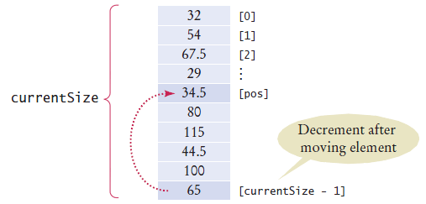
Removing an Element
Suppose you want to remove the element with index pos from the array values.
Removing an Element in an Unordered Array
values[pos] = values[currentSize - 1];
currentSize--;

Slide 99
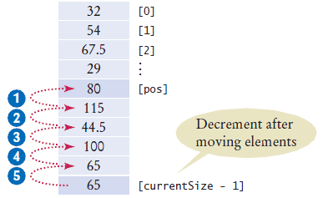
Removing an Element
Removing an Element in an Ordered Array
for (int i = pos; i < currentSize - 1; i++)
values[???] = values[???];
currentSize--;

Slide 100
Removing an Element
Removing an Element in an Ordered Array
for (int i = pos; i < currentSize - 1; i++)
values[i] = values[i+1];
currentSize--;

Slide 101
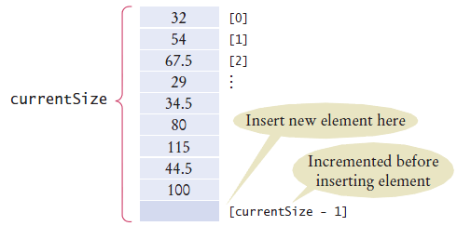
Inserting an Element
If the order of the elements does not matter, you can simply insert new elements at the end, incrementing the variable tracking the size.
if (currentSize < values.length) {
currentSize++;
values[currentSize - 1] = newElement;
}

Slide 102
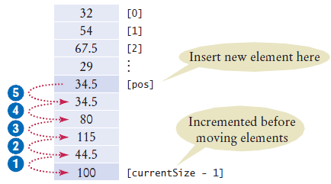
Inserting an Element
It is more work to insert an element at a particular position in the middle of an array.
First, move all elements after the insertion location to a higher index. Then insert the new element.
if (currentSize < values.length) {
currentSize++;
for (int i = ???; i > pos; i--)
values[???] = values[i - 1];
values[pos] = newElement;
}

Slide 103
Inserting an Element
It is more work to insert an element at a particular position in the middle of an array.
First, move all elements after the insertion location to a higher index. Then insert the new element.
if (currentSize < values.length) {
currentSize++;
for (int i = currentSize-1; i > pos; i--)
values[i] = values[i - 1];
values[pos] = newElement;
}

Slide 104
Rotating
rotateToRight()
rotateToLeft()
Test the above methods with
http://cs.tru.ca/~mlee/comp1130/Winter2018/8. arrays/Rotate.java.
http://cs.tru.ca/~mlee/comp1130/Winter2018/8. arrays/UtilRotate.java.

Slide 105
Stack
push()
pop()
In COMP 2230

Slide 106
4. Command-Line Arguments
The signature of the main method indicates that it takes an array of String objects as a parameter.
These values come from command-line arguments that are provided when the interpreter is invoked.
For example, the following invocation of the interpreter passes three String objects into main.
> java StateEval pennsylvania texas arizona
These strings are stored at indexes 0-2 of the array parameter of the main method.

Slide 107
public class CommandLine
{
public static void main(String[] args)
{
for (String arg : args)
System.out.println(arg);
}
}

Slide 108
5. Variable Length Parameter Lists
Suppose we wanted to create a method that processed a different amount of data from one invocation to the next.
For example, let's define a method called average that returns the average of a set of integer parameters.
// one call to average three values
mean1 = average (42, 69, 37);
// another call to average seven values
mean2 = average (35, 43, 93, 23, 40, 21, 75);
Notes:
Invoke: summon into action or bring into existence, often as if by magic

Slide 109
Variable Length Parameter Lists
Idea 1 – We could define multiple overloaded versions of the average method.
Downside: we'd need a separate version of the method for each parameter count.
Idea 2 – We could define the method to accept an array of integers.
Downside: we'd have to create the array and store the integers prior to calling the method each time.
Solution – Instead, Java provides a convenient way to create variable length parameter lists.

Slide 110
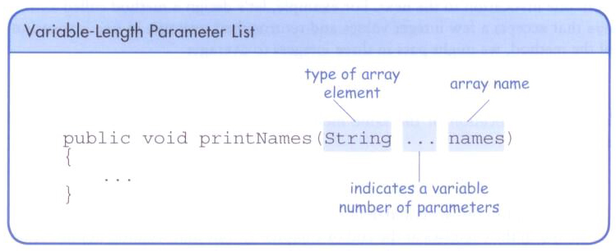
Variable Length Parameter Lists
Using special syntax in the formal parameter list, we can define a method to accept any number of parameters of the same type.
For each call, the parameters are automatically put into an array for easy processing in the method.

Slide 111
Variable Length Parameter Lists
public double average(int ... list)
{
double result = 0.0;
if (list.length != 0) {
int sum = 0;
for (int num : list)
sum += num;
result = (double)sum / list.length;
}
return result;
}
//---- example how to use the above method ----------
mean2 = average (35, 43, 93, 23, 40, 21, 75);
mean3 = average (135, 243, 393);
An array

Slide 112
Variable Length Parameter Lists
The type of the parameter can be any primitive or object type.
public void printGrades(Grade ... grades)
{
for (Grade letterGrade : grades)
System.out.println (letterGrade);
}

Slide 113
Variable Length Parameter Lists
A method that accepts a variable number of parameters can also accept other parameters.
The following method accepts an int, a String object, and a variable number of double values into an array called nums.
public void test(int count, String name,
double ... nums)
{
// whatever
}

Slide 114
Variable Length Parameter Lists
The varying number of parameters must come last in the formal arguments.
A single method cannot accept two sets of varying parameters.
Constructors can also be set up to accept a variable number of parameters.

Slide 115
public class VariableParameters
{
//-----------------------------------------------------------------
// Creates two Family objects using a constructor that accepts
// a variable number of String objects as parameters.
//-----------------------------------------------------------------
public static void main(String[] args)
{
Family lewis = new Family("John", "Sharon", "Justin", "Kayla",
"Nathan", "Samantha");
Family camden = new Family("Stephen", "Annie", "Matt", "Mary",
"Simon", "Lucy", "Ruthie", "Sam", "David");
System.out.println(lewis);
System.out.println();
System.out.println(camden);
}
}

Slide 116
public class Family
{
private String[] members;
//-----------------------------------------------------------------
// Constructor: Sets up this family by storing the (possibly
// multiple) names that are passed in as parameters.
//-----------------------------------------------------------------
public Family(String ... names)
{
members = names; // names is a String array.
}
public String toString()
{
String result = "";
for (String name : members)
result += name + "\n";
return result;
}
}

Slide 117
6. Two-Dimensional Arrays

Slide 118
Two-Dimensional Arrays
A one-dimensional array stores a list of elements.
A two-dimensional array can be thought of as a table of elements, with rows and columns.

Slide 119
Two-Dimensional Arrays
To be precise, in Java a two-dimensional array is an array of arrays.
A two-dimensional array is declared by specifying the size of each dimension separately.
int[][] scores = new int[5][7]; // 5rows, 7cols
A array element is referenced using two index values.
value = scores[3][6]; // scores[3][0], ...
The array stored in one row can be specified using one index.

Slide 120
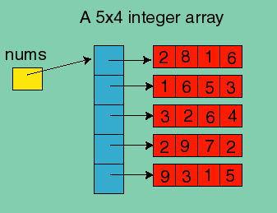
Two-Dimensional Arrays
Internally, Java stores 2 dimensional arrays as an array of arrays:
int [][] nums = new int[5][4];
// create the single reference nums
// (yellow square)
int[][] nums;
// create the array of references (blue squares)
nums = new int[5][]; // nums[i] is an array of integers.
// this create the second level of arrays (red squares)
for (int i=0; i < 5 ; i++)
nums[i] = new int[4]; // create arrays of integers
rows
columns

Slide 121
Two-Dimensional Arrays
When you initially declare a 2D array,
you must always specify the first dimension
nums = new int[][];
// ILLEGAL - NEEDS 1ST DIMENSION
you do not need to specify the second dimension
nums = new int[5][]; // OK
nums = new int[5][4]; // OK
nums = new int[][4]; // Not OK
Elements of the Array: if nums is a 2D array as shown above,
nums[i][j] represents a single integer in that array.
nums[i] represents a 1D array (a single row in the 2D array).

Slide 122
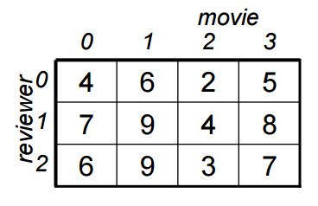
Two-Dimensional Arrays
Find the number of ratings above the value of the parameter.
int[][] rating = new int[3][4];
...
int count = countAbove(rating, 4);
//-------
public static int countAbove(int[][] rating, int num)
{
int count = 0;
for (int row = 0; row < rating.???; row++) {
for (int col = 0; col < rating[???].???; col++) {
if (rating[???][col] > num)
count++;
}
}
return count;
}

Slide 123
Two-Dimensional Arrays
Find the number of ratings above the value of the parameter.
int[][] rating = new int[3][4];
...
int count = countAbove(rating, 4);
//-------
public static int countAbove(int[][] rating, int num)
{
int count = 0;
for (int row = 0; row < rating.length; row++) {
for (int col = 0; col < rating[row].length; col++) {
if (rating[row][col] > num)
count++;
}
}
return count;
}

Slide 124
Two-Dimensional Arrays
Find the average rating by the reviewer in row 2.
int[][] rating = new int[3][4];
int sum = 0;
for (int col = 0; col < ???; col++) {
sum += rating[2][???];
}
double average = (double)sum / 4;

Slide 125
Two-Dimensional Arrays
Find the average rating by the reviewer in row 2.
int[][] rating = new int[3][4];
int sum = 0;
for (int col = 0; col < rating[2].???; col++) {
sum += rating[2][???];
}
double average = (double)sum / rating[2].???;

Slide 126
Two-Dimensional Arrays
Find the average rating by the reviewer in row 2.
int[][] rating = new int[3][4];
int sum = 0;
for (int col = 0; col < rating[2].length; col++) {
sum += rating[2][col];
}
double average = (double)sum / rating[2].length;

Slide 127
Two-Dimensional Arrays
Print the average rating for the movies in column 3.
int[][] rating = new int[3][4];
int sum = 0;
for (int row = 0; row < ???; row++) {
sum += rating[???][3];
}
System.out.println((double)sum / rating.length);

Slide 128
Two-Dimensional Arrays
Print the average rating for the movies in column 3.
int[][] rating = new int[3][4];
int sum = 0;
for (int row = 0; row < rating.length; row++) {
sum += rating[row][3];
}
System.out.println((double)sum / rating.length);

Slide 129
Two-Dimensional Arrays
Expression | Type | Description
table | int[][] | 2D array of integers, or array of integer arrays
table[5] | int[] | array of integers
table[5][12] | int | integer

Slide 130
//********************************************************************
// TwoDArray.java Java Foundations
//
// Demonstrates the use of a two-dimensional array.
//********************************************************************
public class TwoDArray
{
//-----------------------------------------------------------------
// Creates a 2D array of integers, fills it with increasing
// integer values, then prints them out.
//-----------------------------------------------------------------
public static void main(String[] args)
{
int[][] table = new int[5][10];
// Load the table with values
for (int row=0; row < table.length; row++)
for (int col=0; col < table[???].length; col++)
table[row][???] = row * 10 + col;
// Print the table
for (int row=0; row < table.???; row++)
{
for (int col=0; col < table[???].length; col++)
System.out.print(table[???][col] + "\t");
System.out.println();
}
}
}
Test the above program with
http://cs.tru.ca/~mlee/comp1130/Fall2016/6. chapter7/TwoDArray.java.

Slide 131
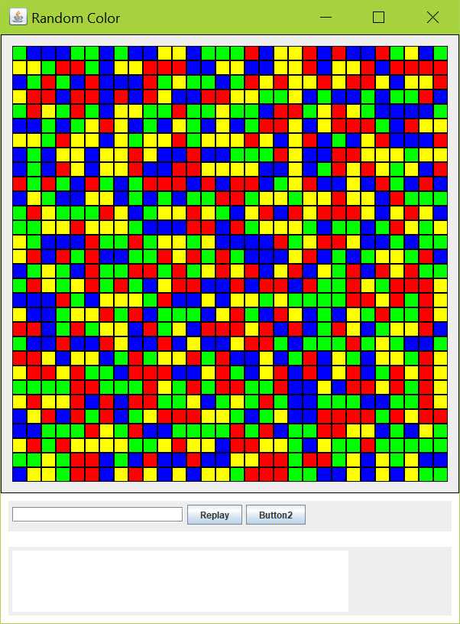
Example - RandomColorBoard
SinGraph
trubgp library
BGPEventListener.class
Board$1.class
Board$2.class
Board.class
Cell$1.class
Cell.class
RandomColorBoard.java
Try it!

Slide 132
Soda Survey
 | Resp 1 | Resp 2 | Resp 3 | Resp 4 | Resp 5 | Resp 6 | Resp 7 | Resp 8 | Resp 9 | Resp 10
Soda 1 | 3 | 4 | 5 | 2 | 1 | 4 | 3 | 2 | 4 | 4
Soda 2 | 2 | 4 | 3 | 4 | 3 | 3 | 2 | 1 | 2 | 2
Soda 3 | 3 | 5 | 4 | 5 | 5 | 3 | 2 | 5 | 5 | 5
Soda 4 | 1 | 1 | 1 | 3 | 1 | 2 | 1 | 3 | 2 | 4

Slide 133
//********************************************************************
// SodaSurvey.java Java Foundations
//
// Demonstrates the use of a two-dimensional array.
//********************************************************************
import java.text.DecimalFormat;
public class SodaSurvey
{
//-----------------------------------------------------------------
// Determines and prints the average of each row (soda) and each
// column (respondent) of the survey scores.
//-----------------------------------------------------------------
public static void main (String[] args)
{
int[][] scores = { {3, 4, 5, 2, 1, 4, 3, 2, 4, 4},
{2, 4, 3, 4, 3, 3, 2, 1, 2, 2},
{3, 5, 4, 5, 5, 3, 2, 5, 5, 5},
{1, 1, 1, 3, 1, 2, 1, 3, 2, 4} };
final int SODAS = scores.length;
final int PEOPLE = scores[0].length;
int[] sodaSum = new int[SODAS];
int[] personSum = new int[PEOPLE];

Slide 134
for (int soda=0; soda < SODAS; soda++)
for (int person=0; person < PEOPLE; person++)
{
sodaSum[soda] += scores[soda][person];
personSum[person] += scores[soda][person];
}
DecimalFormat fmt = new DecimalFormat("0.#");
System.out.println("Averages:\n");
for (int soda=0; soda < SODAS; soda++)
System.out.println("Soda #" + (soda+1) + ": " +
fmt.format((float)sodaSum[soda]/PEOPLE));
System.out.println ();
for (int person=0; person < PEOPLE; person++)
System.out.println("Person #" + (person+1) + ": " +
fmt.format((float)personSum[person]/SODAS));
}
}

Slide 135
Multidimensional Arrays
Any array with more than one dimension is a multidimensional array.
Each dimension subdivides the previous one into the specified number of elements.
Each dimension has its own length constant.
Because each dimension is an array of array references, the arrays within one dimension can be of different lengths.
These are sometimes called ragged arrays.

Slide 136
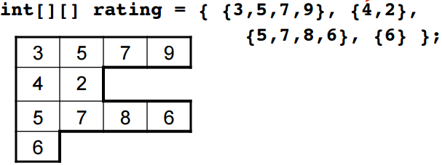
Multidimensional Arrays (Ragged Arrays)
Since a 2D array is a 1D array of references to 1D arrays, each of these latter 1D arrays (rows) can have a different length.

Slide 137
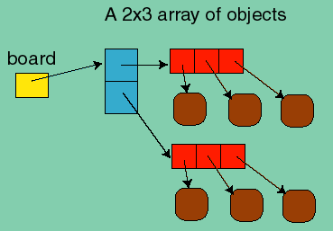
2D Array of Objects
A 2D array of objects is an array of an array of references to objects.
// creates the single reference nums (yellow square)
Square [][] board;
// creates the array of references to arrays (blue squares)
board = new Square[2][];
// creates are arrays of references to objects (red squares).
for (int i=0; i < board.length ; i++)
board[i] = new Square[3]; // create arrays of references to objects
The above instructions can be combined into the instruction:
Square [][] board = new Square[2][3];
However, we still have not created any objects! To create objects, there is no simple way other than with loops:
for (int i=0; i < board.length ; i++)
for (int j=0; j < board[i].length ; j++)
board[i][j] = new Square(i,j,color);

Slide 138
Multidimensional Arrays
One way to visualize a four-dimensional array:
Two-dimensional arrays are common, but beyond that usually an array has other objects involved.

